Slide 1
Personalized Healthcare Estimates using Crowdsourcing Techniques
Maritza Mills, Elexie Munyeneh, Justin Robinson, Manuel Balbuena

Slide 2
Problem
Patients in the US medical system are often unable to know direct medical costs at time of service. This leaves patients unable to compare costs across different types of services and healthcare providers resulting in higher costs than necessary due to a lack of information. Too many patients don’t seek preventative medical care for fear they cannot afford it.

Slide 3
Proposal
Our solution aims to help bring more transparency to healthcare costs at the individual and aggregate level by collecting information for out of pocket costs, provided directly from patients themselves, cooperating healthcare entities and publicly available information, such as Medicare data or information about free clinic locations, urgent care facilities to help patients control their healthcare costs.
This data is combined with the patient’s healthcare history to offer personalized estimates related to specific procedures, insurance costs and most affordable providers.

Slide 4
How do we collect the data?
Data is collected in several ways:
Directly from patients via web app
Publicly available government data
Cooperating entities (hospitals and insurers)

Slide 5
How will it be used to help the patient?
Healthcare data can be provided in aggregate to show average costs for specific types of procedures and visits to specialists. The patient’s personal demographics can be compared with aggregated data to help the patient understand how their factors unique to them may affect these specific costs.

Slide 6
Who else Benefits?
The patient isn’t the only one that benefits from this arrangement. Below are all relevant parties that benefit from crowdsourced healthcare data and more informed patients.
 | Party Involved | Benefit
 | Patient | Patients can lower their out of pocket costs for healthcare and worry less about bills and more about getting quality healthcare.
 | Healthcare Providers | Providers can benchmark their patients cost against averages to identify areas of improvement.
 | Insurance Companies | Insurance companies benefit by helping their customers lower overall healthcare costs, lowering payments for the insurer in the process.
 | Government | The city of Charlotte can use this data to understand where inefficiencies are and make informed decisions about healthcare policy.

Slide 7
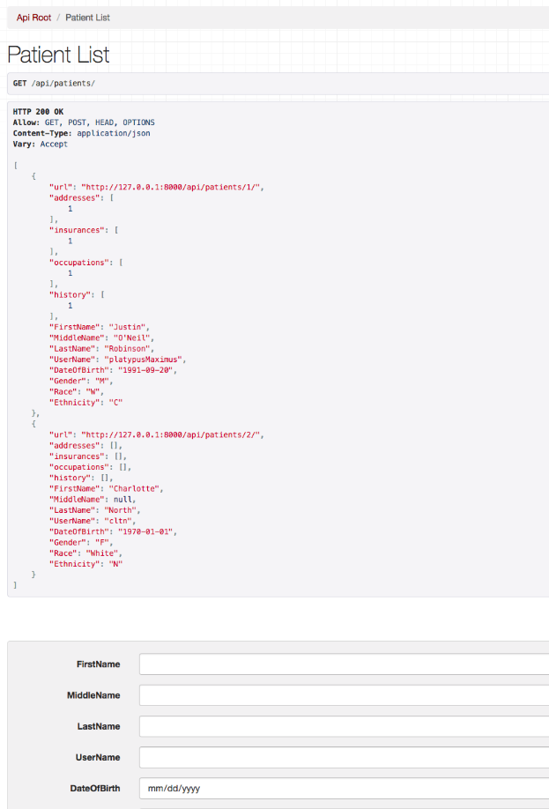
What we built
Front End: Web interface where users can enter specific data about themselves which is then added to the data set.
Model: Regression Tree Learner with Python that was trained on the Cardinal Solutions claims data using inputs such as race, ethnicity, gender, diagnosis, and service summary and produces a single cost estimate for each row submitted.
Webservice: Using Django, serves the data from our front end into the database and from the database to the classifier

Slide 8
The Future
After entering personal information such as demographics, medical history and relevant provide information we can allow users to quickly choose a “reason for visit” from a dropdown and provide an estimated health cost for the visit.
Recommendations can be made to show users how to lower their cost information, such as using urgent care for non-critical visits versus an emergency room visit.
We can also proactively alert patients to opportunities which will help them lower their healthcare costs, such as times for free clinic operations.
Patients and other entities will also have the ability to view healthcare information in aggregate, to understand average costs, and how costs have changed over time.
Partner with hospital networks to integrate claims data into system.

